Slide 1
STAT 50 Review Day 3
5/13/2021

Slide 2

























Slide 3
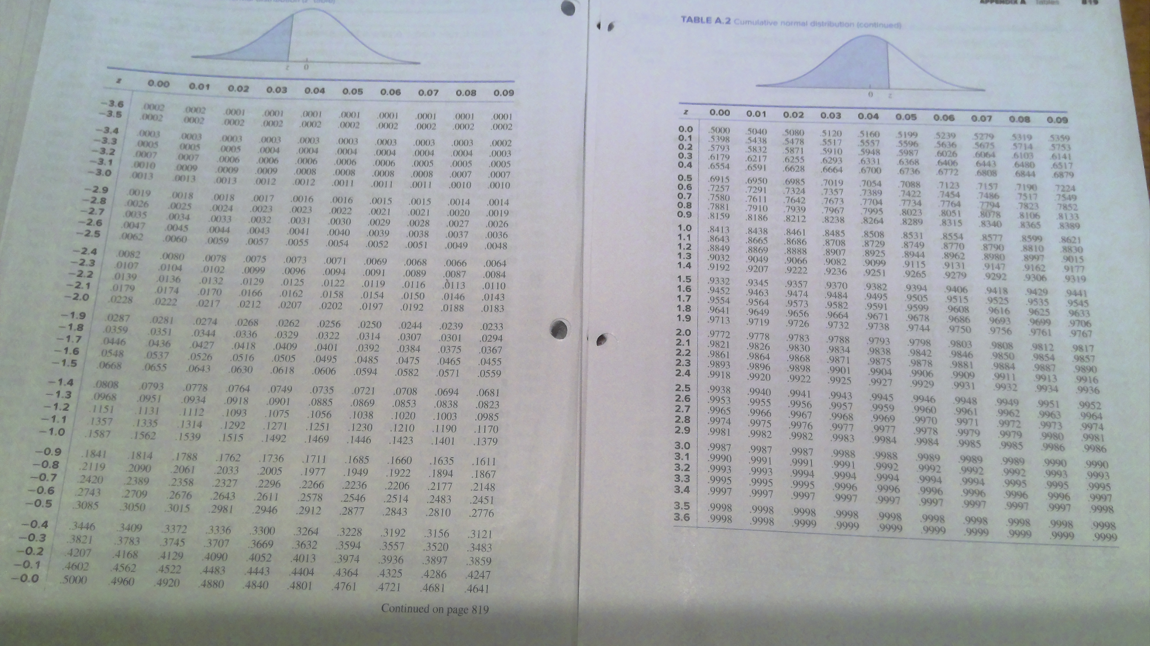

Slide 4
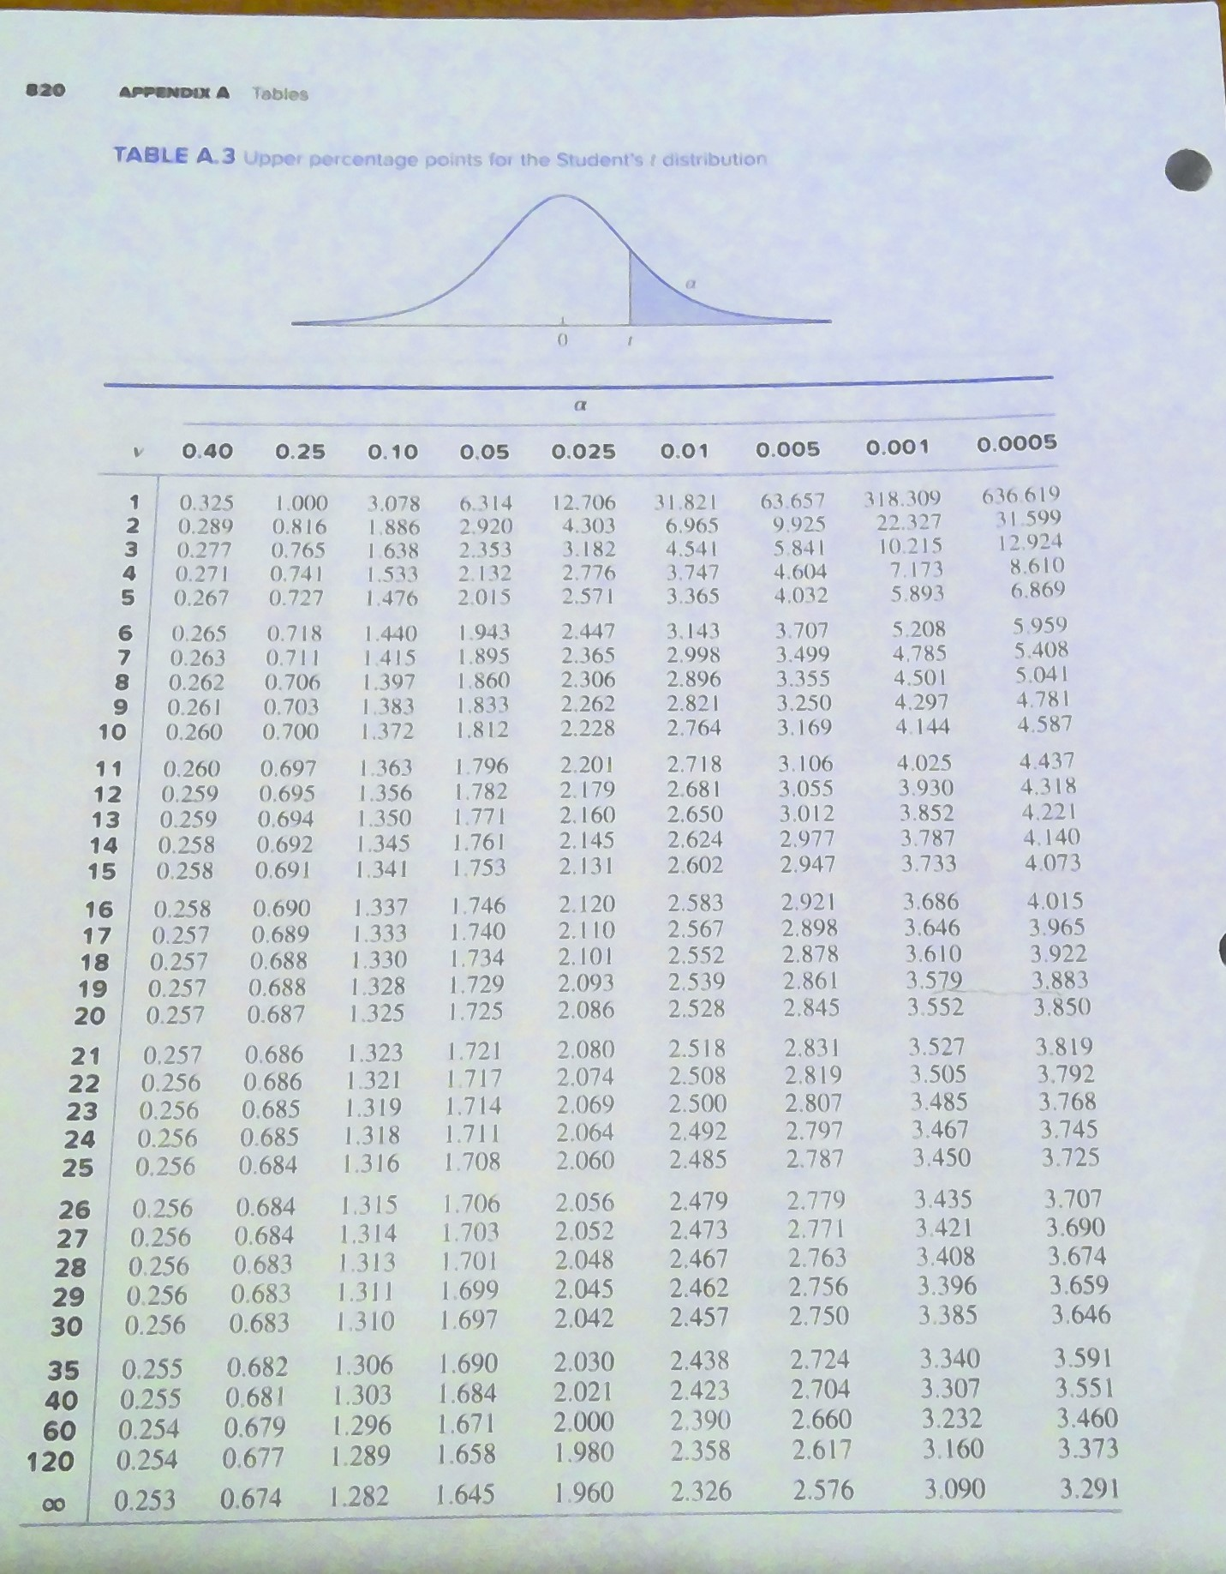

Slide 5
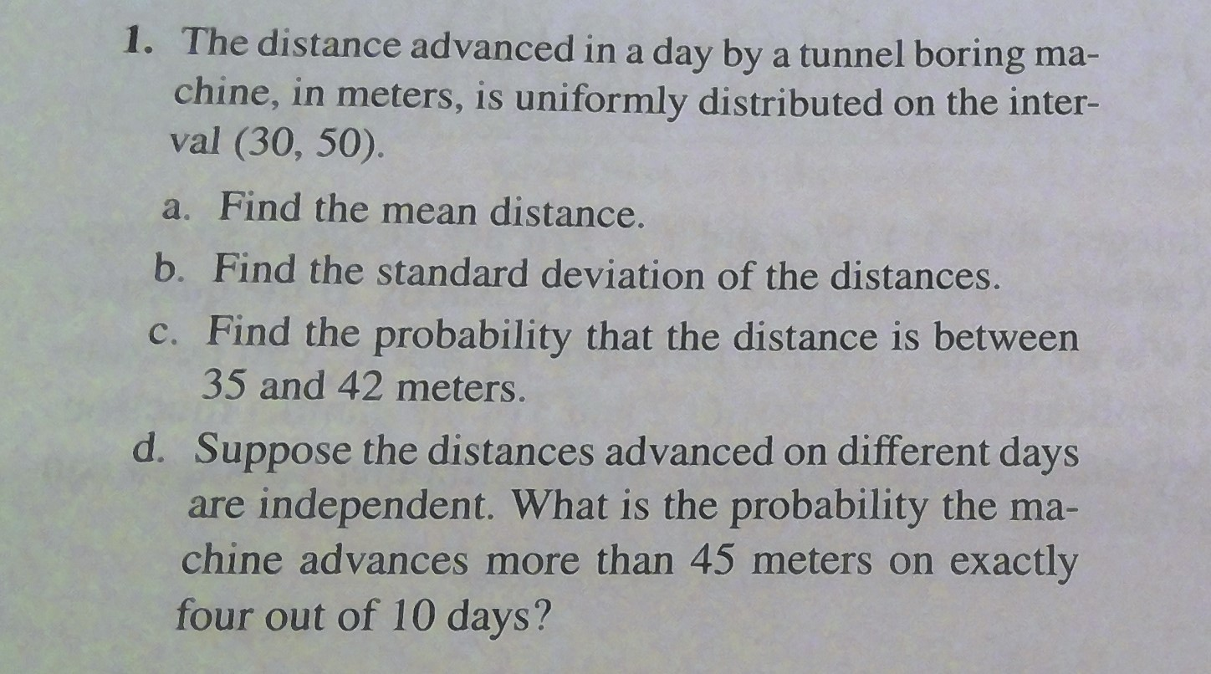

Slide 6


















Slide 7
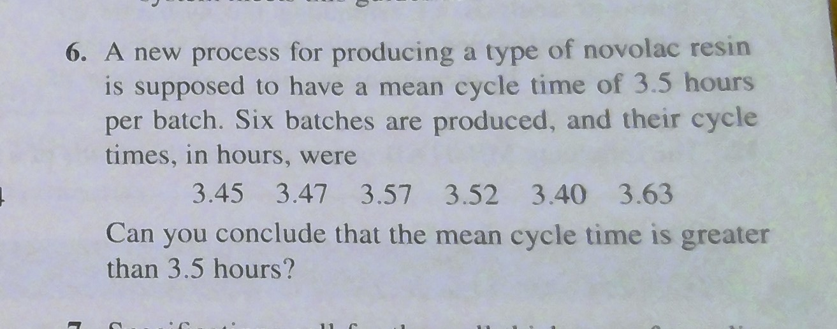

Slide 8















Slide 9























Slide 10
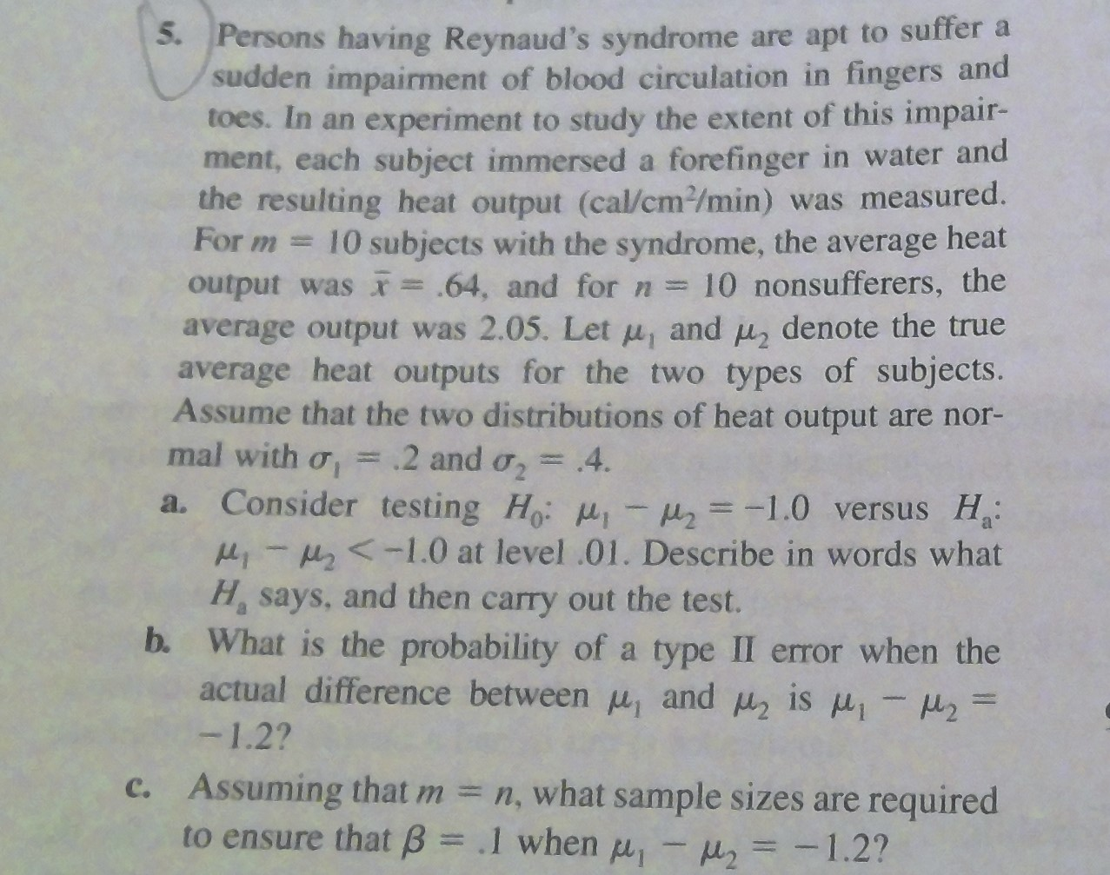


Slide 11














Slide 12



































Slide 13





























Slide 14
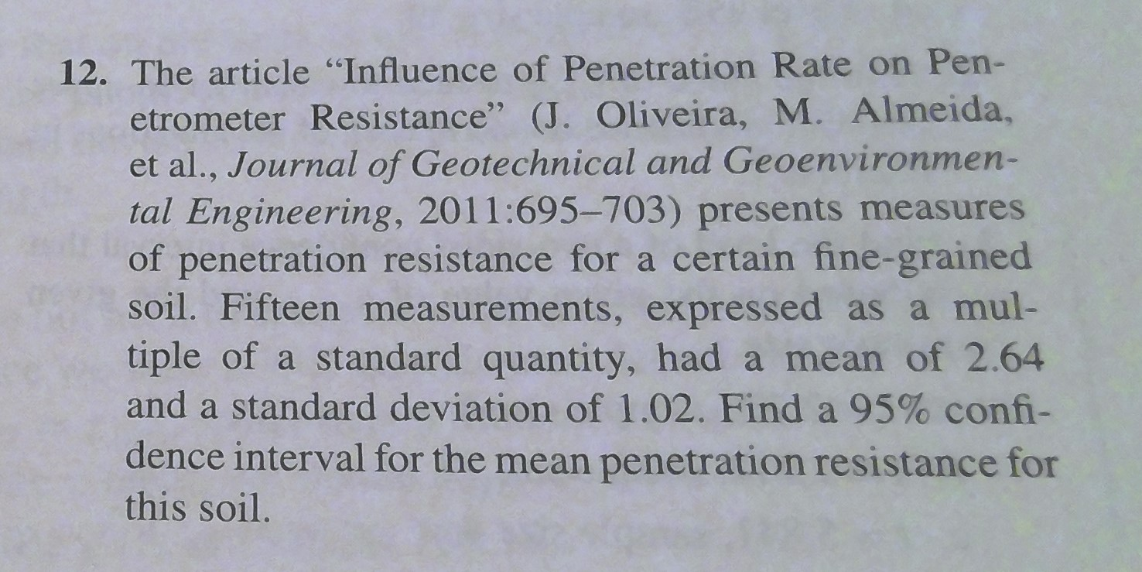

Slide 15



























Slide 16
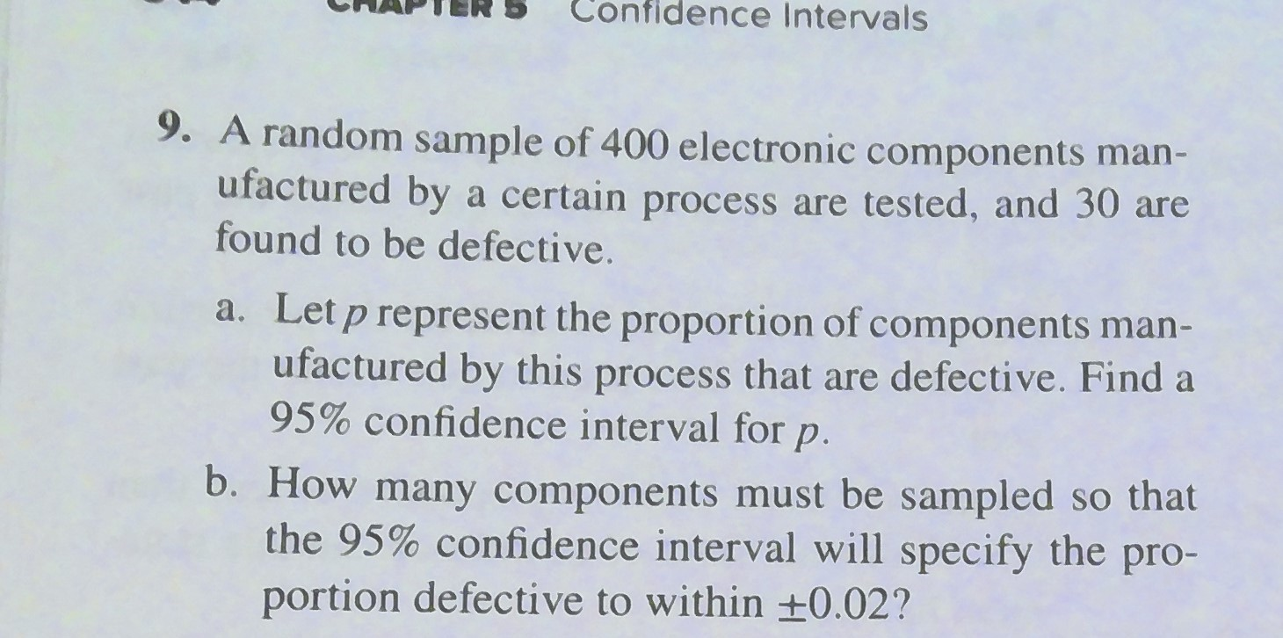

Slide 17
































Slide 18








Slide 19
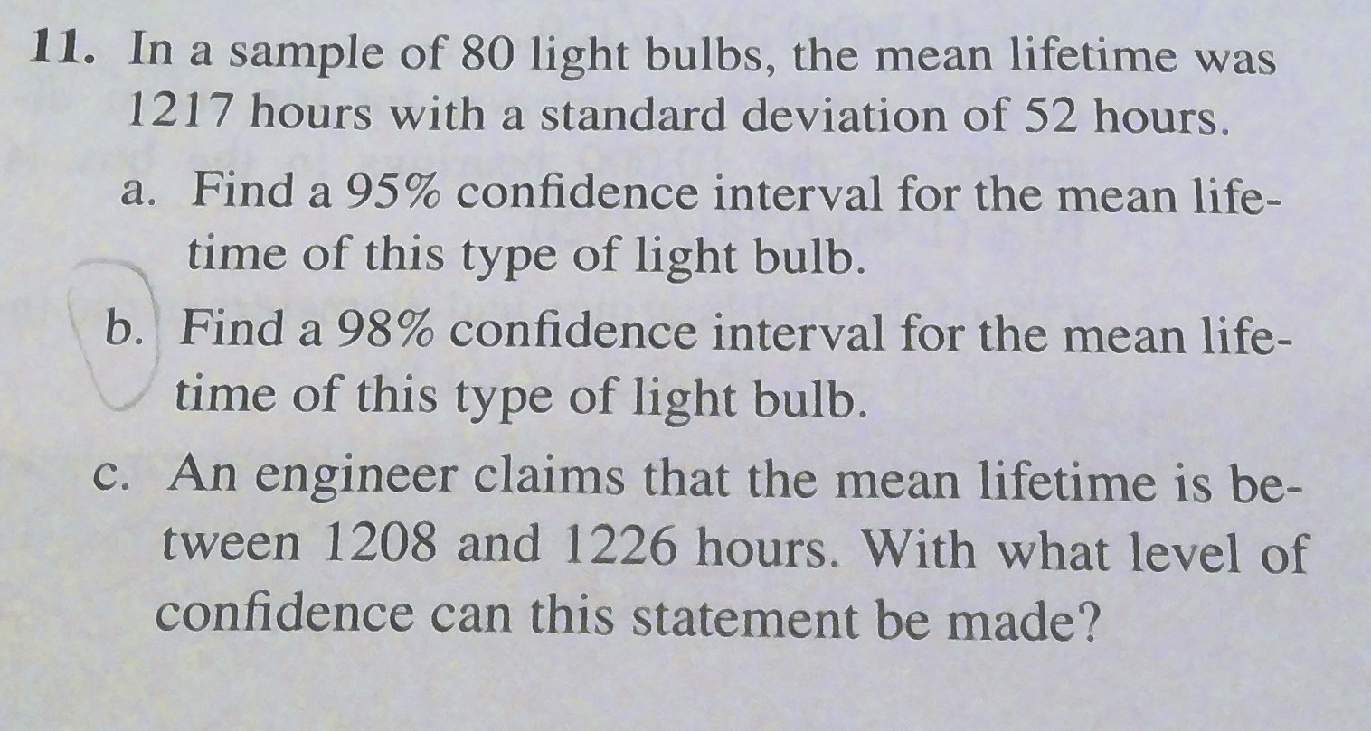


Slide 20
















